Slide 1
Group Project.init() Presentation
CS 401-01 | Group 5

Slide 2
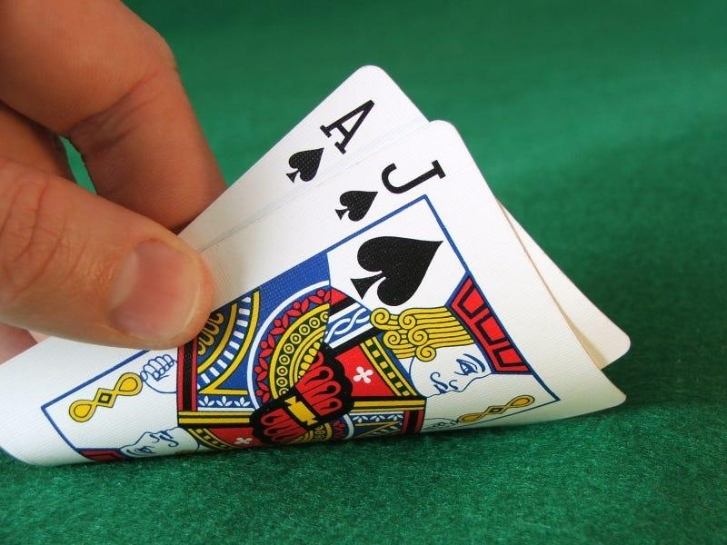
Project Topic - Blackjack
To create a functional online game of Blackjack that is able to host a group of players that can personally interact with other concurrent users. The game will closely model its real life counterpart, while making slight modifications to make it easier to play on the computer.

Slide 3
Top 10 Requirements for Blackjack
> System must follow standard blackjack rules
> Using a standard six-deck game (312 cards)
> Aces are considered 1 or 11. All face cards are considered 10. All other cards are its own value
> Minimum and Maximum bets are $2 - $500
> If a player goes bust, they lose their wager regardless
> Dealers must stand if their total is 17 or more
> Players win their bet if they don’t go bust & are higher than the dealer at the end
> No payment is given if there is a “stand-off”
> The deck must be reshuffled once enough cards have been used from the current deck

Slide 4
Top 10 Requirements for Blackjack
> Functional system to play blackjack
> What can the player do during the game?
> Player must bet before playing
> After cards are dealt, player has the choice to Split a Pair or Double down if possible. Otherwise they will play their turn normally. If the condition is met, player may also bet on “Insurance” instead.
> Player can either “Hit” or “Stand” with their cards until a winning condition is met
> Depending on the win / loss condition, players or dealer will receive the bet money accordingly

Slide 5
Top 10 Requirements for Blackjack
Other Functional Requirements
Ability to log in and out of an account.
Accounts will be preset to log into to either be a dealer or player
Ability to add funds (abstractly) for an account balance
Ability to cash out balances
System to join, leave, and start in games of blackjack in "rooms"
A lobby system in which rooms will be dynamically made as needed when rooms are filled
Having a cost / funds requirement in order to join a room
Other Non Functional Requirements
Design a unified UI that includes both dealer and player views. Ensure that only the view selected by the user (dealer or player) is displayed in the interface.
Must be formatted in Java and functional through a GUI
Notes:
Make the user and dealer be using the same gui but omit the buttons/interaction correspondingly

